Slide 1
Muhtasin Arif Chowdhury

Slide 2
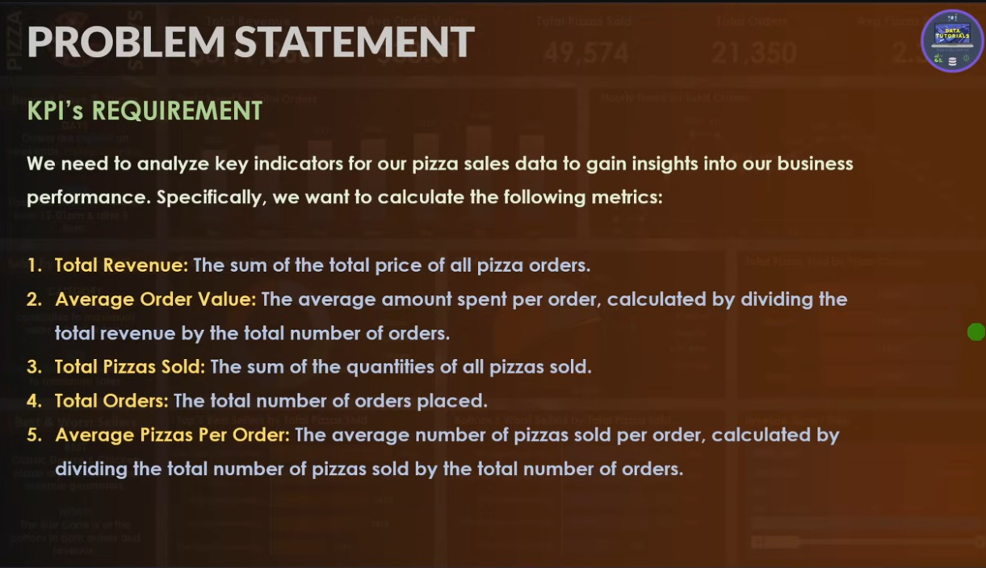

Slide 3
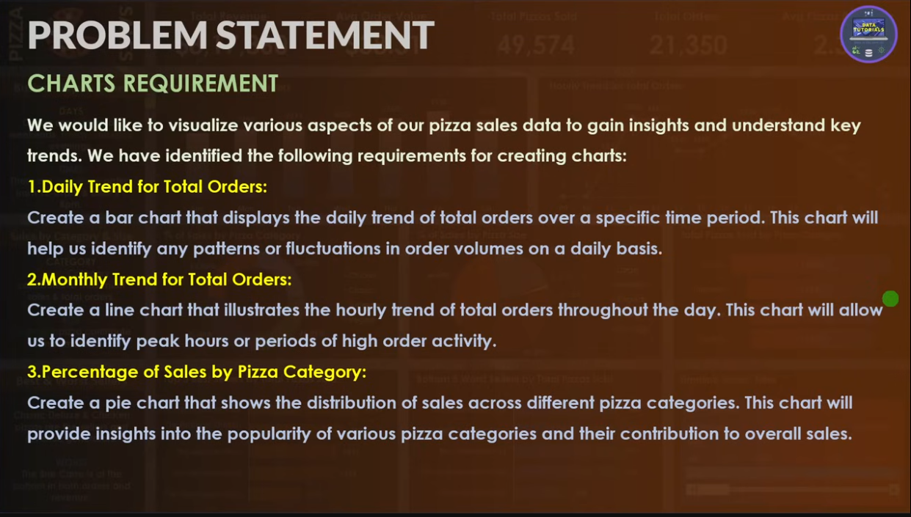

Slide 4
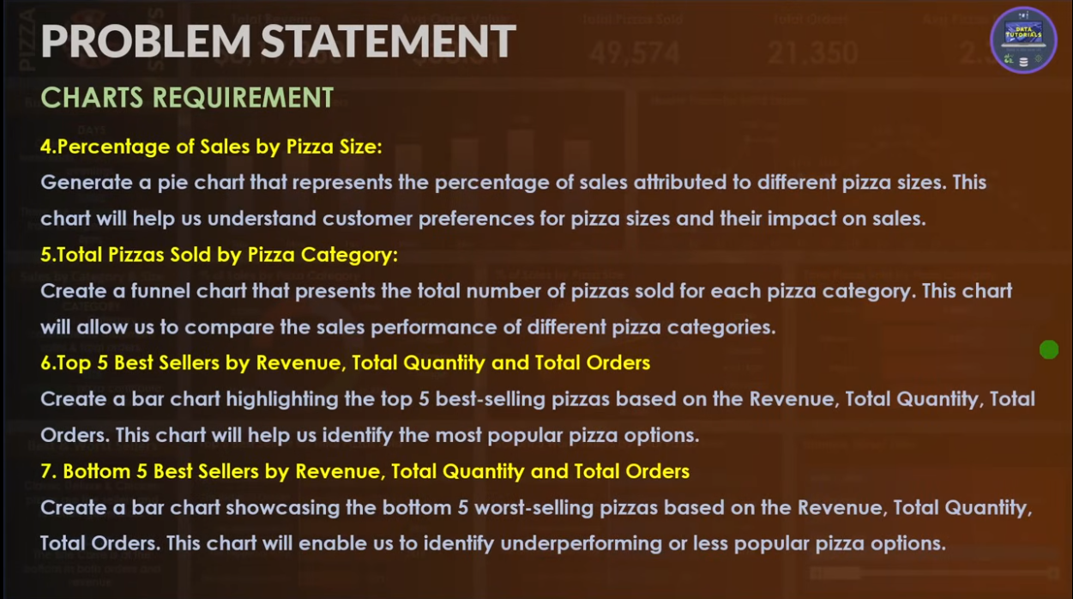

Slide 5
